Slide 1
Data Science and Python
Get Started with Data Science and Python
Axita Gupta
04/16/2020

Slide 2
Goals/Objectives
Empower
Visualize &Analyze
Develop Predictive Model
Define the problem within a data science framework & understand difference between Data Analytics & Data Science.
Develop model that can predict or detect potential defaulters .
Set up local working environment. Visualize & Analyze CreditOne data
Since past one year or so Credit One has seen an increase in the number of customers who have defaulted on loans
If this problem is not solved Credit One can loose their business
Main goal - design and implement a creative, empirically sound solution to predict or detect credit card defaulters.
Identify the potential causes of credit card default.
Axita A Gupta – Course 5 Task 1

Slide 3
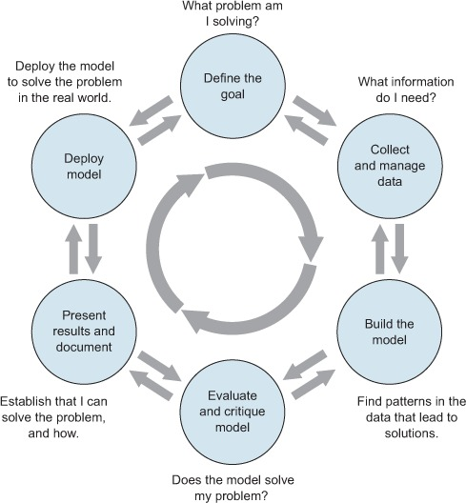
Data Science Process – Zumel & Mount
The ideal data science environment is one that encourages feedback and iteration between the data scientist, stakeholders, and between the different stages of the data science process.
Data science cycle divided into 6 stages that overlap each other.
After a project is complete and model is deployed, its possible that questions may arise.
Therefore, end of one project may lead into a follow-up project.
Zumel and Mount, Practical Data Science with R, chapter 1
Axita A Gupta – Course 5 Task 1

Slide 4
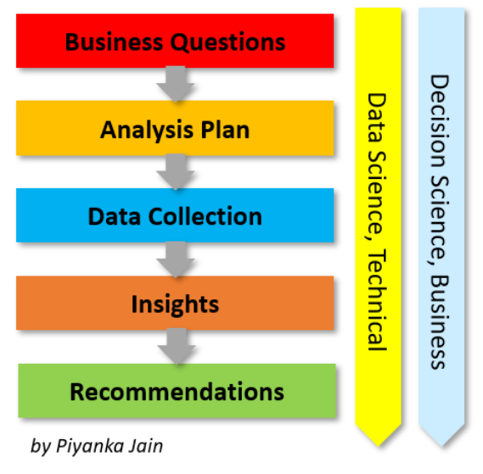
Data Science Process - BADIR
Aims to provide actionable insights through data.
It is best applied to business outcomes and key performance indicators.
It uses historical data to solve a business problem.
It focuses on accelerated improvement versus stability
It has an inbuilt system to learn any business context.
Both methods provide a great platform to explain the flow of a data science process.
For this project BADIR method will be a good data science process to solve the credit card default problem because it aims to provide important insights through data and can be modified based on business problem and requirement.
https://aryng.com/aryng-BADIR-advantage
Axita A Gupta – Course 5 Task 1

Slide 5
Understanding Data
Location of Data Collection - Case of customers default payments in Taiwan
Data Collected - from April to September, 2005)
Variables in Data:
Binary Response variable, default payment (Yes = 1, No = 0)
Total 23 variables : X1 to X23
X1: Amount of the given credit (NT dollar): it includes both the individual consumer
credit and his/her family (supplementary) credit.
X2: Gender (1 = male; 2 = female).
X3: Education (1 = graduate school; 2 = university; 3 = high school; 0, 4, 5, 6 = others).
X4: Marital status (1 = married; 2 = single; 3 = divorce; 0=others).
X5: Age (year).
X6 - X11: History of past payment.
-2: No consumption; -1: Paid in full; 0: The use of revolving credit; 1 = payment delay for one month;
2 = payment delay for two months; . . .; 8 = payment delay for eight months; 9 = payment delay for nine months and above.
X12-X17: Amount of bill statement (NT dollar).
X18-X23: Amount of previous payment (NT dollar).
Axita A Gupta – Course 5 Task 1

Slide 6
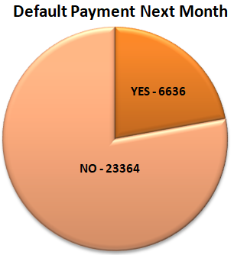
Issues With Data
No missing data
Imbalance in the default payment next month – Data set shows that 6636 out of 30000 customers will default next month.
Dataset is not highly imbalanced.
Axita A Gupta – Course 5 Task 1

Slide 7
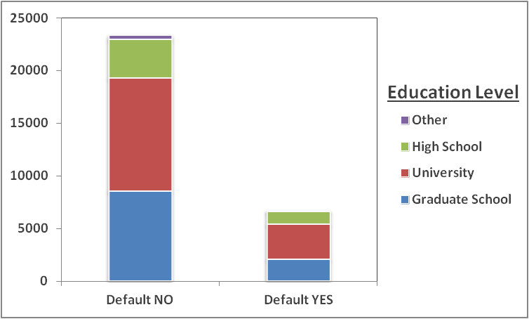
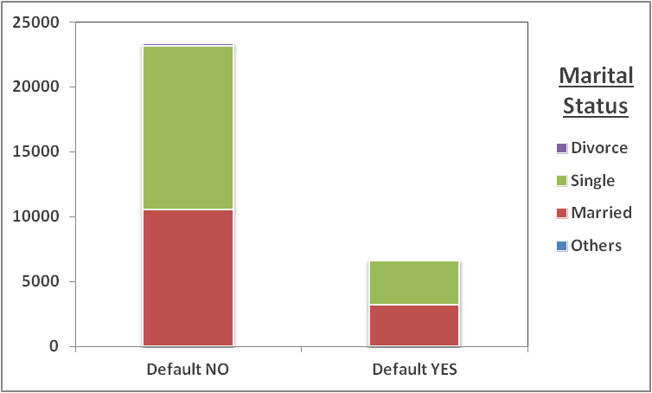
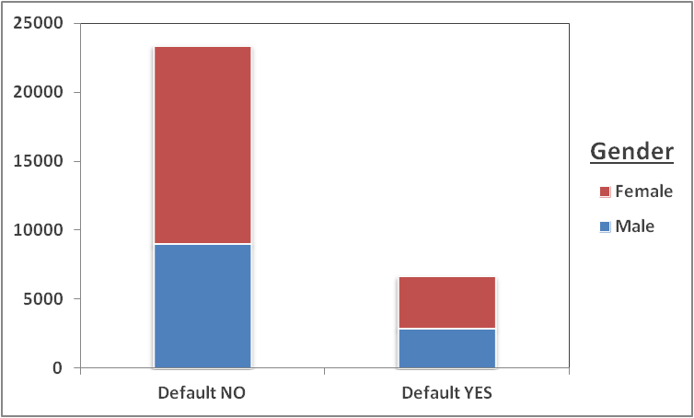
Exploring Data
By Education Level – For both default YES/NO majority people are with graduate school and university education.
By Gender – For both default YES/NO no. of females are higher than males.
By Marital Status – For both default YES/NO either people are single or married.
Axita A Gupta – Course 5 Task 1

Slide 8
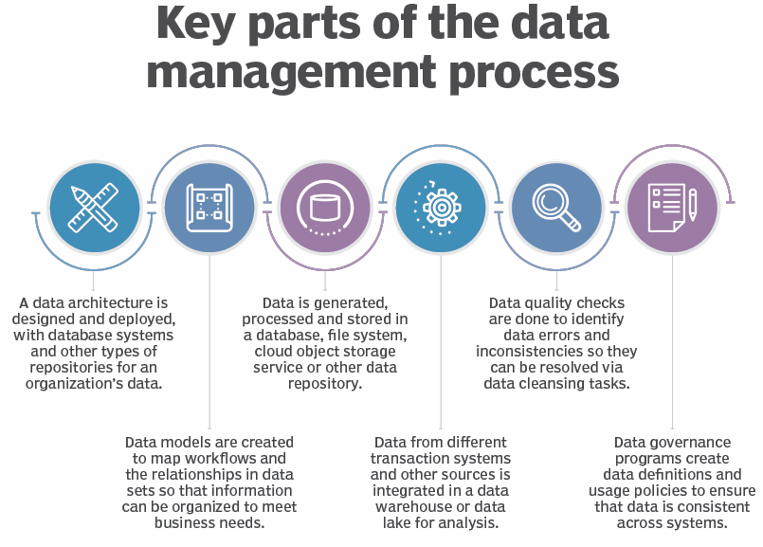
Managing Data For Project
Managing data for a project is a process that includes ingesting, storing, organizing and maintaining the data created and collected by an organization.
One of the most important stage that includes following important steps:
What data is available?
Will it help solve the problem?
Is it enough?
Is the data quality good enough?
Data is asset for any company since data helps take informed decisions and ultimately help in increasing profits and revenue
Zumel and Mount, Practical Data Science with R, chapter 1
https://searchdatamanagement.techtarget.com/definition/data-management
Axita A Gupta – Course 5 Task 1

Slide 9
Visualizations with Analysis - Flowchart
Capture Data
This flowchart clearly shows the 5 different stages of data analysis that will be followed in this study
Any issues with the data will be taken care off by managing and cleaning data stage.
Major pitfalls if any encountered will be found in exploratory data analysis stage and can be taken care off during this stage
Manage & Clean Data
Reporting
Flowchart
Showing Detailed Process
Final
Analysis
Exploratory
Data Analysis
EDA
Axita A Gupta – Course 5 Task 1

Slide 10
High-Level Recommendations About Existing Data
The business objective is to determine key drivers that lead to credit card default and develop model that can predict if the customer will default or not.
Need to analyze credit default payment data with greater detail and then develop model that can predict if the customer will default in future.
Data Given is limited to only six months of data from April to September 2005. It will be good to have more data from previous years so that better predictions can be made.
This domain research and exploratory analysis can be better understood if more information is available about the data like:
Income level of people
Employment History - If the person is employed or not
Analyzing more historical credit card data
Credit history if the person has any kind of debt
Axita A Gupta – Course5 Task 1

